Slide 1
Booster Board and Volunteer Positions
The heart of our BASIS Scottsdale community are our volunteers.

Slide 2
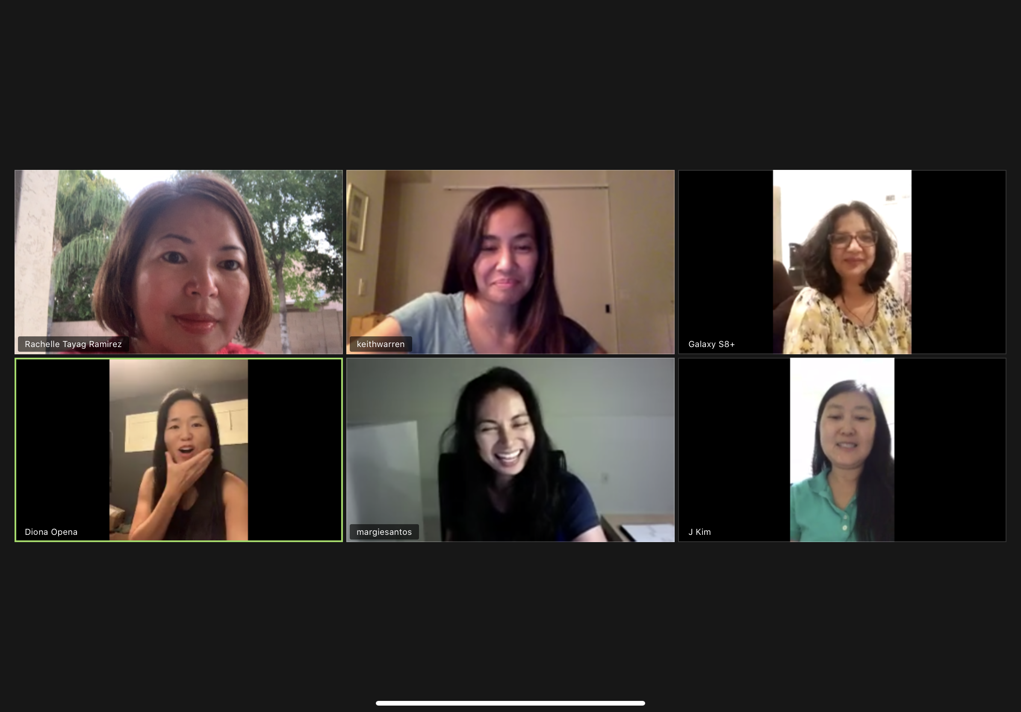
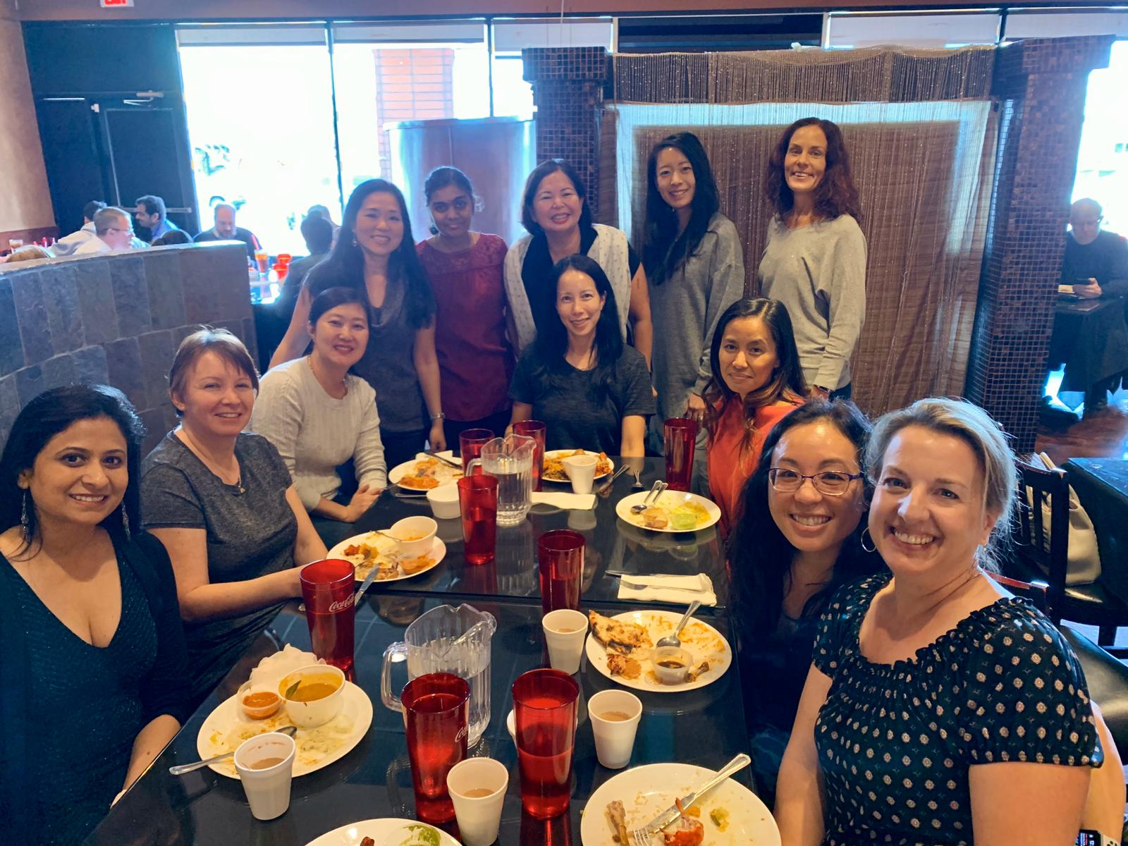
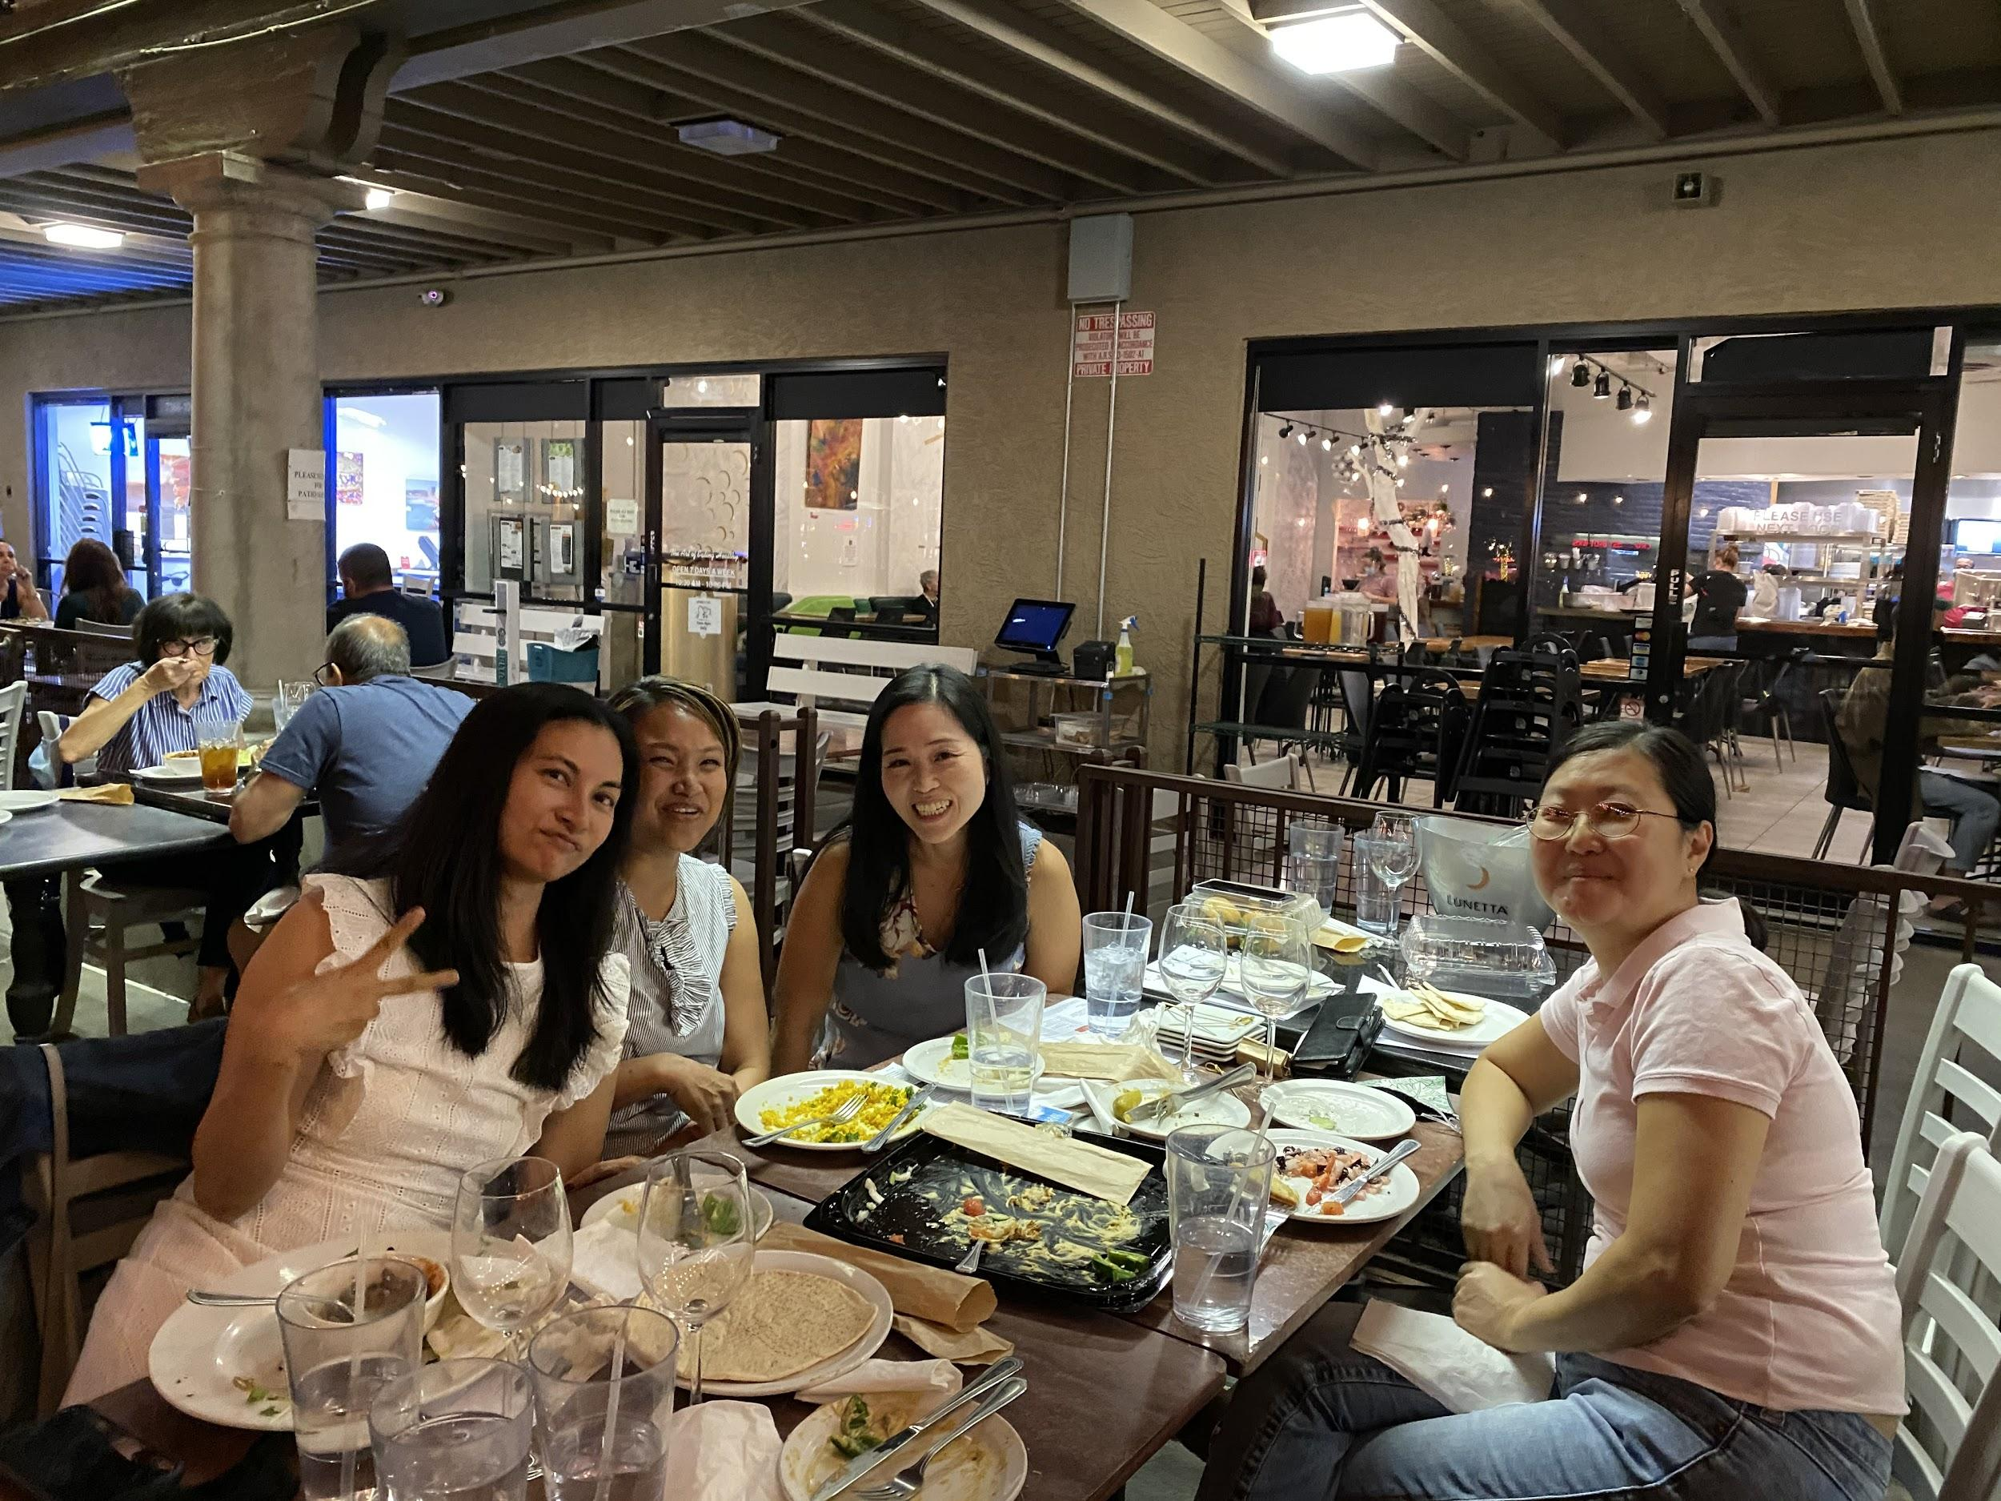
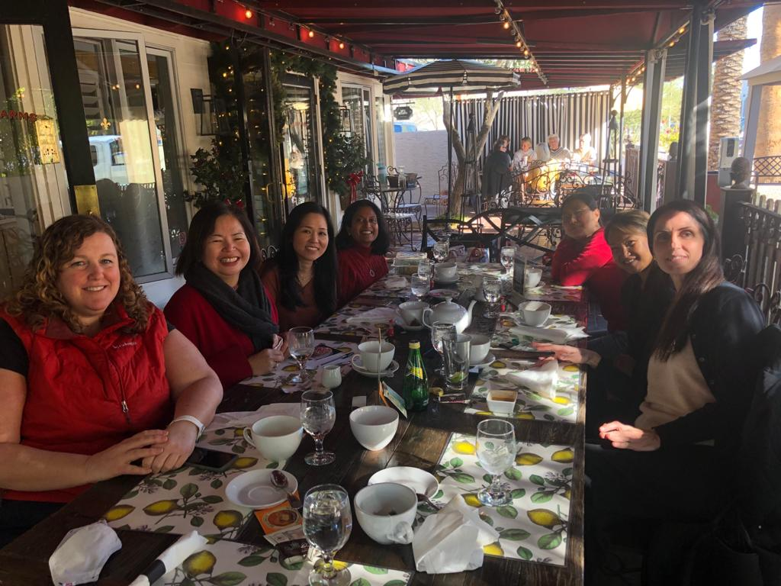
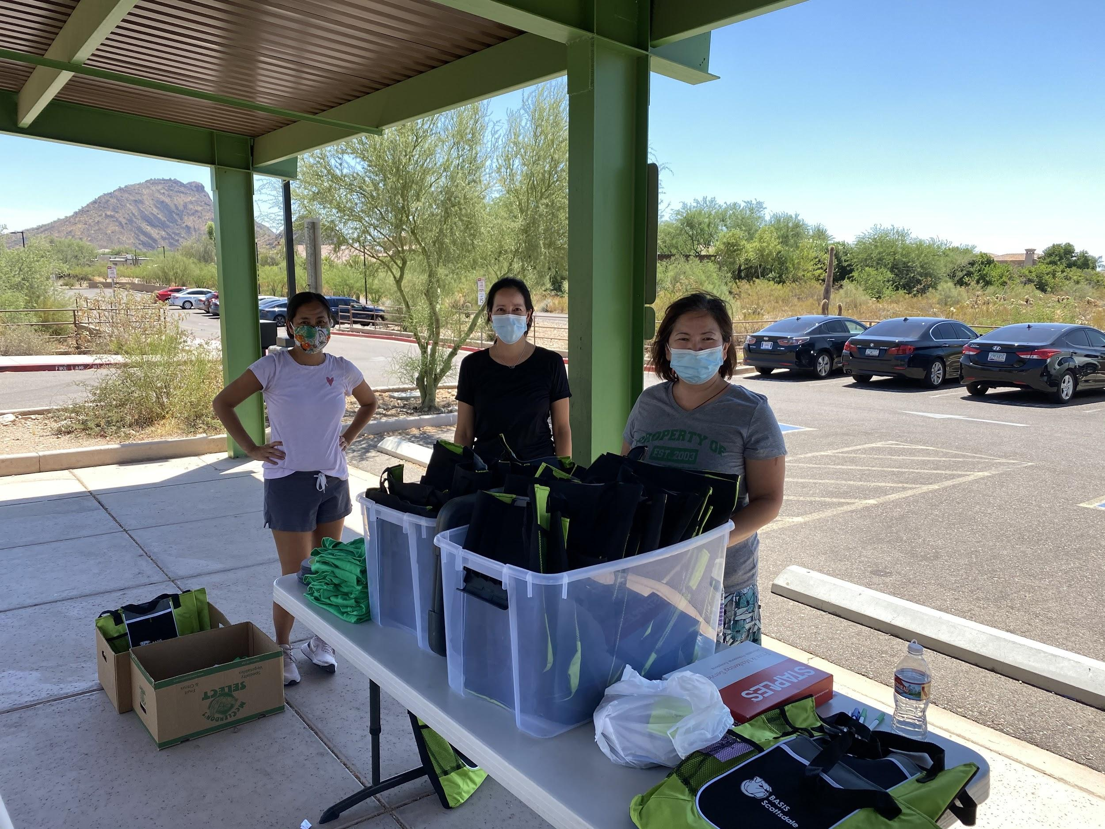
Making a difference, creating friendships…
And supporting
our students!

Slide 3
President
Liaison with HOS and HOPs
Set Annual Goals for the Boosters and Board
Coordinates Calendar of Events between Boosters and School
Works with Treasure to develop, approve and oversee annual budget
Manage P&L Statement to ensure good financial health
Organizes meetings with with HOS, HOPs and members
Build and lead a positive community of students, faculty and parents who work together to achieve the Booster’s Mission and Charter
Oversee Board positions and Committee Chair positions, not overseen by other VPs
Assist Board Members with keeping inventory in Storage Cage Organized
Time Commitment: 1 to 4 hrs/week (around 8 hrs/wk if a large event is occurring)

Slide 4
Secretary
Take notes (minutes) during meetings
Publish minutes
Update and/or create documents & letters for the organization (ie. Annual Teacher Appreciation Letter for Gift)
Coordinate merchandise and Boosters inventory
Responsible for keeping inventory in Storage Cage Organized, with the support of other board members.
Work with the President and the board to document anything they require
Become familiar with all documents in the BASIS Boosters Inc. shared drive
Time Commitment: 1 hr/week (around 8 hrs/wk if a large event is occurring)

Slide 5
Treasurer
Set up Annual Budget & provide monthly reporting on financial health
Manage Finances
Reconcile Bank Accounts & Lunch invoices monthly
Issue payments to volunteers, vendors, and Annual Teacher Appreciation Gifts.
Manage PayPal, PayPal Giving Fund, GoFund Me, Clover, Weebly Purchases, Lunch Purchases
Transfer $ between PayPal & bank accounts
Produce and report P&L Statements quarterly at board meetings
Update Bank Account and credit card holder’s information.
Submit records (P&L/Balance Sheet) to CPA for annual Tax Filings
Fiscal Year ends June 30th. Taxes must be filed by Nov 15th, unless extension is filed, and then they are due May 15th.)
Manage all Corporation Commission filings and name updates
Manage Certificate of Insurance with Insurance Carrier (PTO Today)
Time Commitment: 2 to 3 hrs/week. Plus a few full days in early December to write checks for Teacher Appreciation Gifts

Slide 6
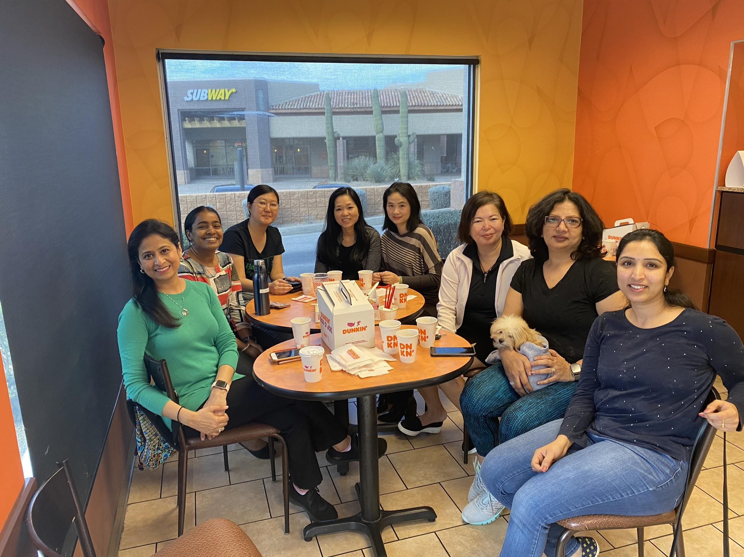
VP Lunch
Oversee:
Lunch Chairs
Monday
Tuesday
Wednesday
Thursday
Friday
Coordinate Lunches
Speak with vendor
Hold monthly meeting with Lunch Chairs to discuss improvements
Coordinate special lunches (ie. Chick-Fil-A) or Treats (Jamba Juice)
Time Commitment: 1 to 2 hrs/wk (around 8 hrs/wk if a large event is occurring)

Slide 7
VP Communications
Oversees and manages communication platforms
Website: Managing the Boosters website , content creation and periodic updates
Newsletters: Boosters newsletters and Boosters information for School wide Blast
Email: Email blasts to different parent groups
Social media presence : Facebook page and whatsapp groups
Graphics : Creating Flyers, Posters and Banners for Online and Offline Campaigns
E Commerce: Setup purchase and ordering items/tickets on website and provide order summaries
Setup Booster email accounts for different heads
Coordination with other Board members for their specific communication requirements
Lead the following committees: Newsletter, website and graphics chairs
Time Commitment: 5 hours per week( average), more time is required during events and campaigns

Slide 8
Social Co-Chairs
Oversee:
Social Chair for Upper School
Social Chair for Lower School
Plan & Assist in Social Events
Back to School Event (Water park or Movie in Park)
End of year celebration for both upper and lower schools
Aid & Coordinator with Leadership club (Winter Formal, Hoopcoming & Prom)
Time commitment: 1 to 3 hrs/week (around 8 hrs/wk if a large event is occurring)
Functionality
Work with Fundraising Chair to ensure events are producing $$$
Attend all board meetings to relay information to teams
Work with President & Treasurer to ensure adequate funding
Fe a fiduciary
Be actively engaged with chairs & update them with important info
Be available to your chairs whenever possible
Assist Board Members with keeping inventory in Storage Cage Organized

Slide 9
Fundraising Co-Chairs
Oversee:
Sponsorship Chair
Passive Fundraising Chair
Set up Restaurant Nights
Come up with new ideas to generate revenue
Ads on website
Sponsorship of Events or Activities
Time Commitment: 1 hr/wk (around 8 hrs/wk if a large event is occurring)

Slide 10
Other Committee Chairs
Teacher Appreciation Co-Chairs
Organizes the teacher appreciation luncheons that occur at the end of each grading period
Organizes the faculty snack pantry
Organizes the Faculty Holiday Party in December
Time Commitment: 4-6 hours per month
College Hospitality Co-Chairs
Provides materials and gifts for the College Counselors to hand out to college reps visiting our school.
Time Commitment: 1 hour per month
Parent Appreciation Co-Chair
Organizes Coffee Hour and other events that bring parents together
Time commitment: 2 hours per month.

Slide 11
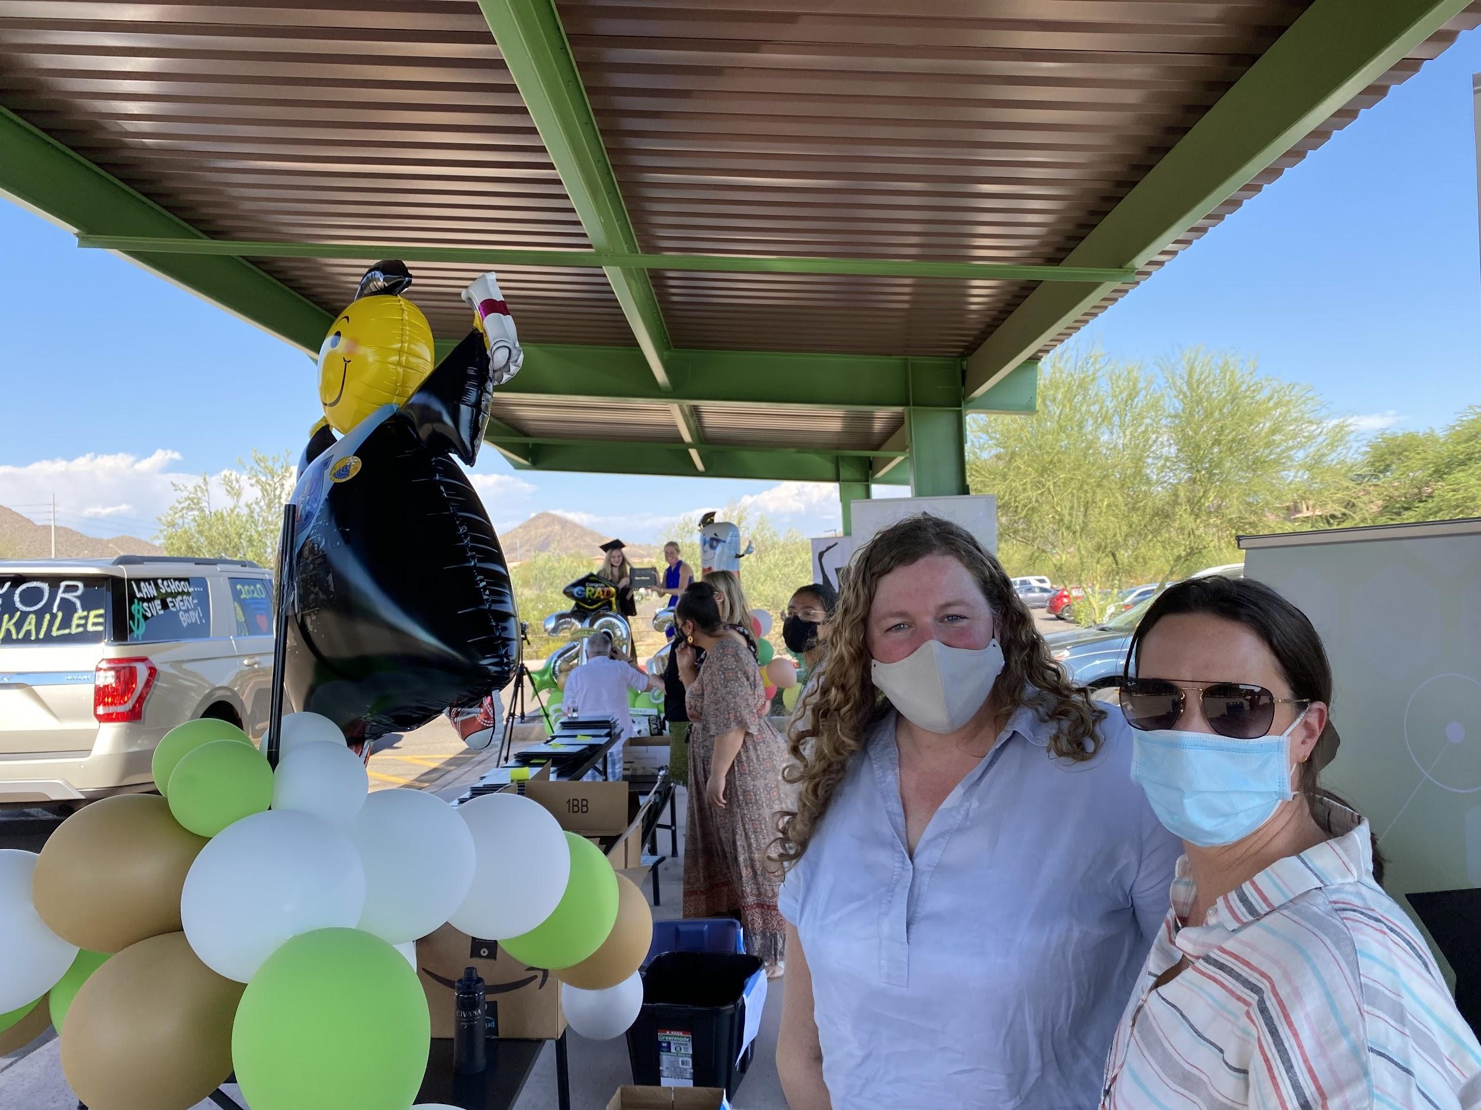
Other Board Member Responsibilities:
Meet in person or via Zoom Regularly
Twice/month initially, then monthly
Needs to have some availability during the school hours or before school for meetings &/or school events. For example, we have the following events that need Board Support:
Back to School Bash (School hosted event where Boosters sells memberships & merchandise usually the Friday before school starts and requires all hands on deck! Board members usually work in shifts)
Monthly Parent Meetings and/or Coffee Hours (8 to 9 am)
Teacher Appreciation Lunches (drop in between 10 am to 1 pm to support our committee chairs)
Faculty Appreciation Holiday Party (Friday evening in early December )
Supporting Social Events before, during or after school
Setting up posters in pick up line
Delivering supplies
Work together as a team
Asist and/or participate in Social and Fundraising Events
Get to know other parents and staff at school
Have a lot of fun!

Slide 12
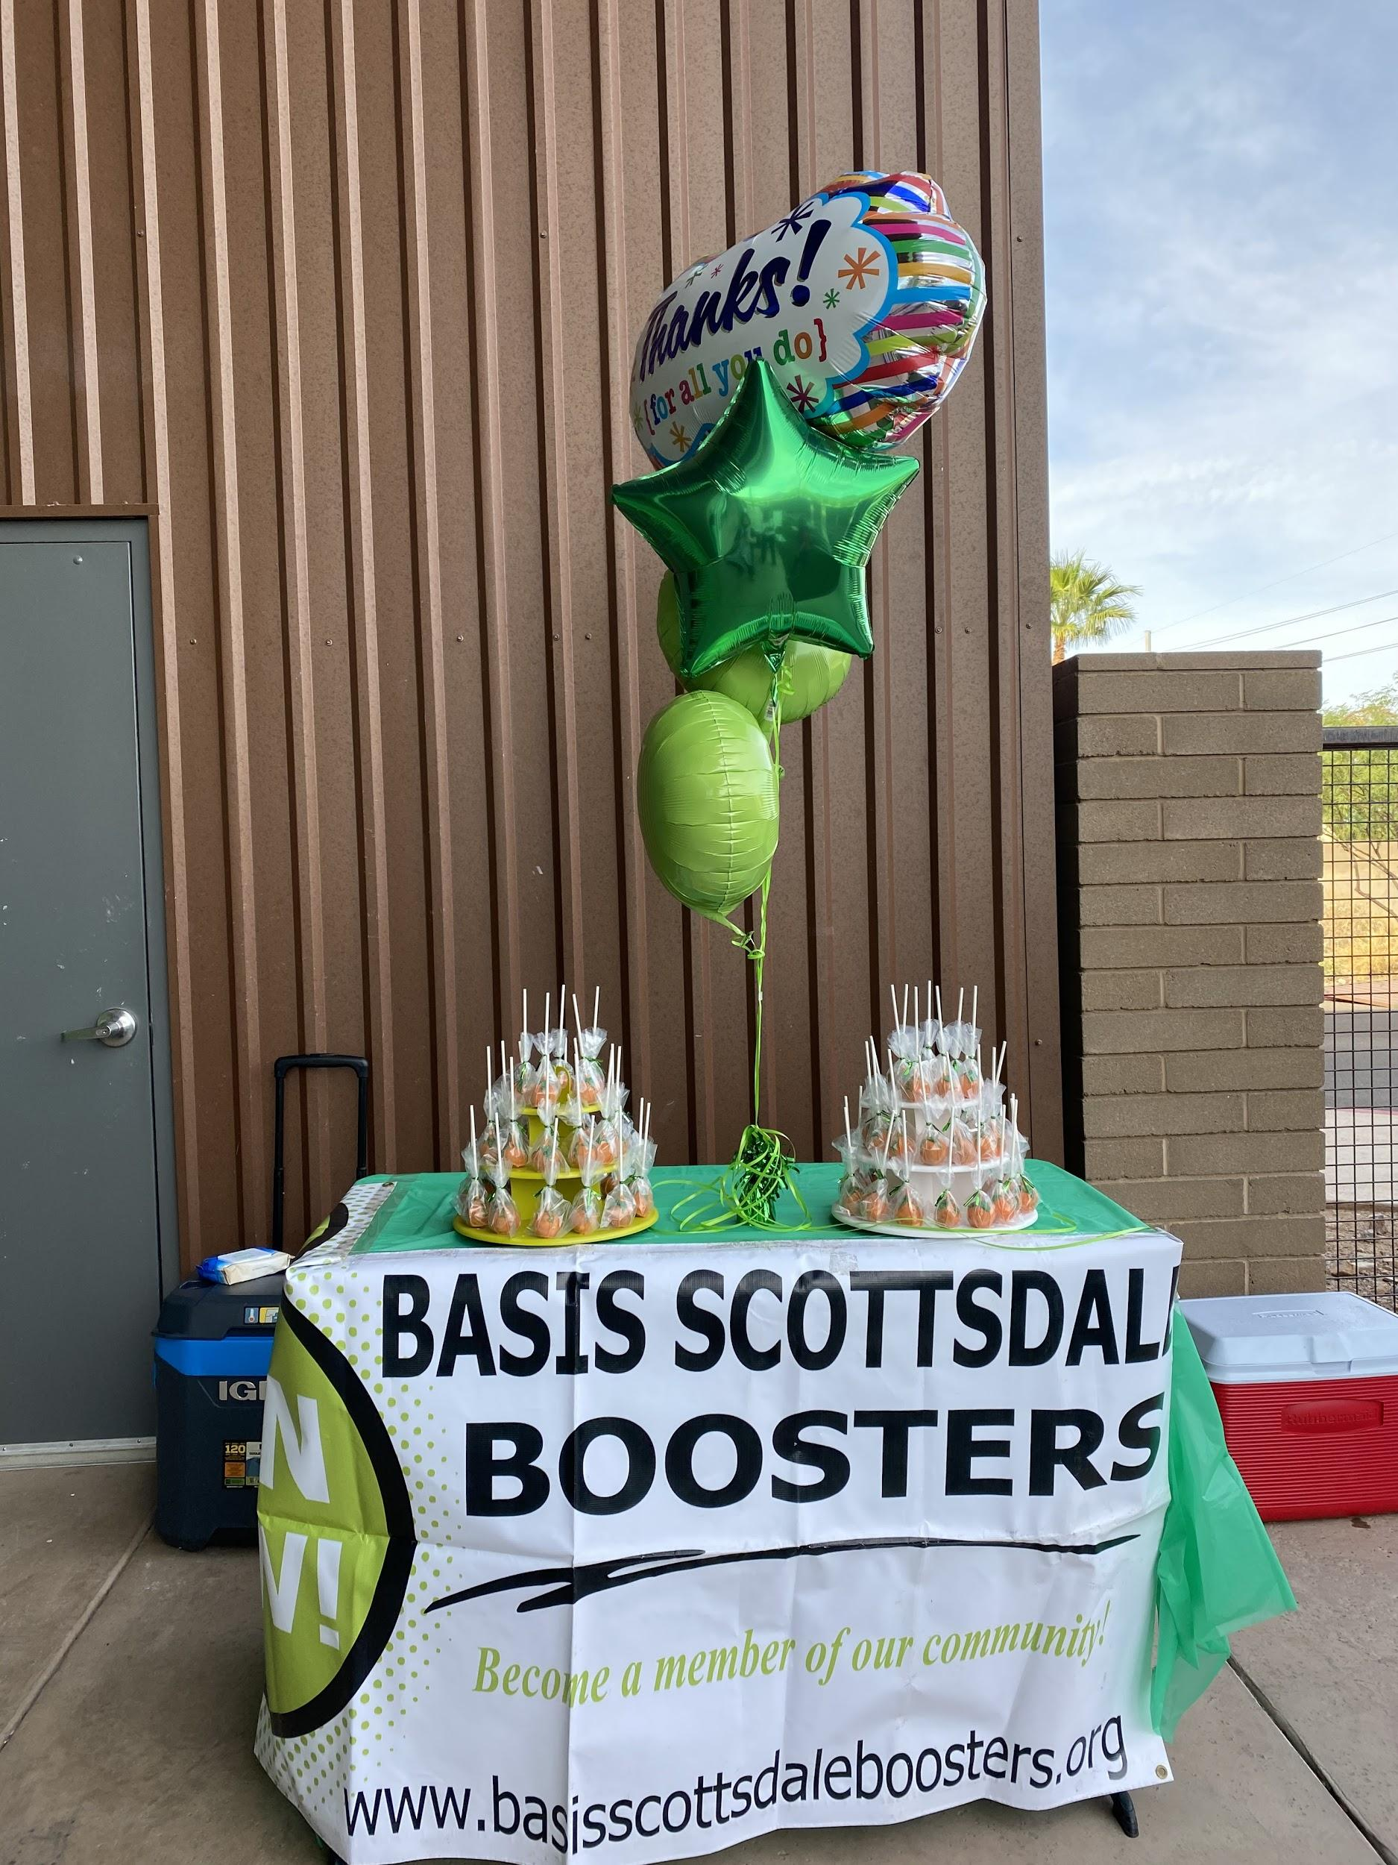
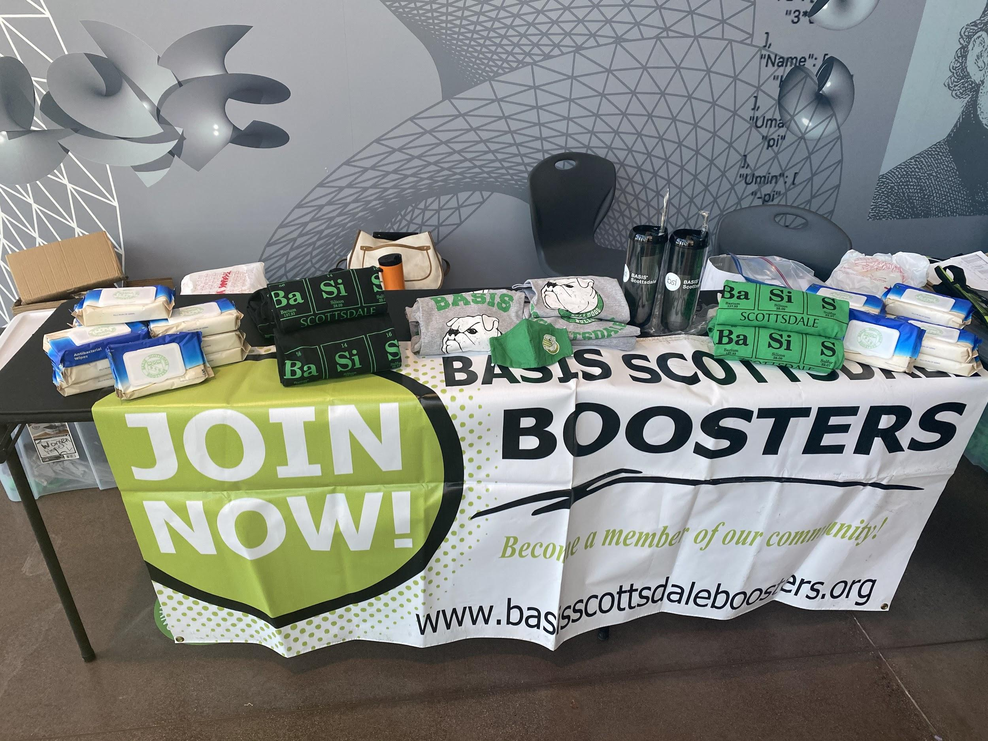
Questions?
email: Info@BASISScottsdaleBoosters.org

Slide 13
